Slide 1
The impact of Global Fund transition strategies on national HIV programs in Central Asia.
Transition and Sustainability: Lessons, Questions and Priorities
Anna Deryabina, MD, MScIH, DrPH
Director for Central Asia
ICAP at Columbia University
July 26, 2018

Slide 2
Introduction
88%
55%
54%
63%
57%
62%
57%
MOH data from the EHCMS, as of June 30, 2018

Slide 3
Introduction
Overall funding for HIV:
Kazakhstan: 3 grants, $58,333,951 disbursed since 2003
Kyrgyzstan: 3 grants, $61,006,151 disbursed since 2004
Tajikistan: 5 grants, $83,464,961disbursed since 2003
Global Fund supported:
Involvement of community-based organizations and NGOs
Commodities
Technical assistance, trainings and financial incentives for staff
Government covered the cost of infrastructure and personnel

Slide 4
Kazakhstan
Immediate effect on HIV programs
Very limited funding for NGOs to conduct HIV prevention, harm reduction and ART adherence support activities
All ARVs are procured by the government, but the funding is limited.
~$11.6mln instead of ~$20.3mln for ARVs in 2019.
Limited funding for viral load testing

Slide 5
Potential impact
Prevalence of HIV among MSM
National IBBS data
Number of new HIV infections 2008-2017
EHCMS data
6.2%
3.2%
MOH IBBS data
MOH data from the EHCMS

Slide 6
Kyrgyzstan
Immediate effect on HIV programs
27 months (Oct’15-Dec’17) – $20.8 mln
36 months (Jan’18-Dec’20) - $23.4 mln
Decreased funding for NGOs to conduct HIV prevention, harm reduction and ART adherence support activities. Only 10 NGOs by 2020.
Reducing the number of NSP sites from 21 to 15
Reducing the number of MAT sites from 30 to 24
Reduced financial incentives for clinical staff
National HIV Program Budget for 2018-2020
~$48,000,000
UNDP/Global Fund PIU data

Slide 7
Tajikistan
27 months (Oct’15-Dec’17)– $17.1 mln
36 months (Jan’18-Dec’20) - $12.9 mln
Immediate effect on HIV programs
Decreased funding for NGOs to conduct HIV prevention, harm reduction and ART adherence support activities
No free HIV testing for labor migrants and sex partners of PWID
No STI testing and treatment
Reduced funding for NSP (1 syringe per PWID per day; 250 clients per 1 outreach worker)
National HIV Program Budget for 2018-2020
$40,986,740
UNDP/Global Fund PIU data

Slide 8
Suggestions on how to close the gap
Integration of services into the primary healthcare
Integration of opioid substitution maintenance (OST) and needle and syringe distribution (NSP) services into routine mental health and substance use treatment programs
Implementation of state social contracting of NGOs for HIV-related activities
Optimization of ARV procurement mechanisms and other cost reduction strategies
Implementation of different co-payment schemes
Creation of a national HIV fund

Slide 9
Programs “at the highest risk”
Opioid substitution maintenance programs
Needle and syringe programs
Community-based ART initiation and adherence support programs
Community based programs focusing on key populations, especially MSM, including social support and legal services
Prompt introduction of new ART drugs, PreP
Test & Start

Slide 10
Conclusions
National budgets of countries in Central Asia are not ready to take over the funding of their national HIV programs
HIV prevention programs focusing on key populations are most at-risk for discontinuation and scale-down
Without clear transition strategies and prioritization of HIV funding achievement of 90-90-90 goals will remain challenging

Slide 11
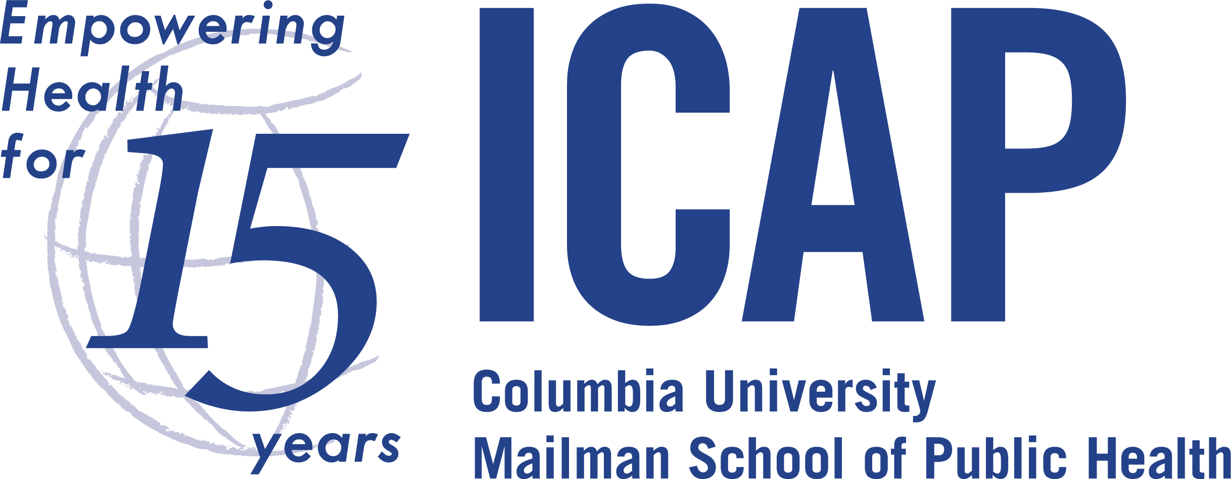
Acknowledgments
Colleagues at ICAP-NY and in Central Asia: Valeriya Kryukova, Ainagul Isakova, Yunus Mirzoaliev, Viktor Ivakin and Megan Urry
UNDP/Global Fund PIU staff- Oksana Katkalova (Kyrgyzstan) & Mavzuna Burkhanova (Tajikistan)
Meerim Sarybaeva from UNAIDS in Kyrgyzstan
Republican AIDS Center in Kazakhstan – Tatyana Davletgalieva

